Slide 1

Bridging Academic Open-Source EDA to Real-World Usability
ICCAD-2020
Austin Rovinski*, Tutu Ajayi*, Minsoo Kim†, Guanru Wang*, Mehdi Saligane*
* University of Michigan, Ann Arbor, MI
† University of California, San Diego, CA
Notes:
Hi everyone,
First I would like to thank my co authors and teammates for all their work and effort. Also I would like to thank Tom Spyrou and Prof. Andrew Kahng for putting together this special session.
Today I will present our paper which is about “Bridging Academic open source EDA to Real world usability”
This work has been driven by the umich and ucsd and is supported in part by the DARPA IDEA program as a part of the OpenROAD project.

Slide 2
ASIC Design: Expertise, Schedule, Cost, RISK
Modern “Place and Route” tool: 10000+ commands/options
Hard to design with latest tools in latest technologies
Quality and schedule are unpredictable
Expert users are required
Cost and risk block innovation
Notes:
We all know that ASIC Design is difficult, expensive, and risky.
Tools have thousands of command-option combinations.
They are complicated and unpredictable. You need expert users.
This brings cost and risk and cripples innovation.

Slide 3
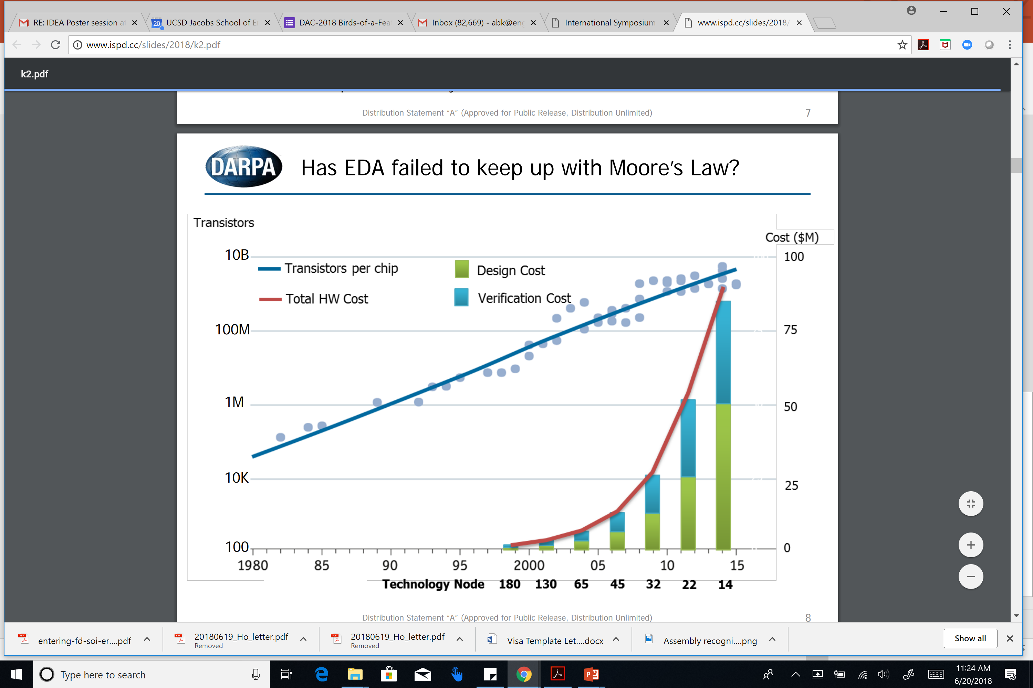
ASIC Design: Expertise, Schedule, Cost, RISK
Modern “Place and Route” tool: 10000+ commands/options
Hard to design with latest tools in latest technologies
Quality and schedule are unpredictable
Expert users are required
Cost and risk block innovation
Notes:
We see pictures like [CLICK] these: on the left is the problematic raised by DARPA in Andreas Olofsson’s talk where we can see that
– the cost of silicon is under control. The cost of designing in silicon is out of control.
The histogram on the right is extracted from the Synopsys Analyst Day talk, the cost for companies to design a 5nm IoT SoC chip is likely to be nearly 100% larger than the cost to design a 7nm chip,
while costs to design a 7nm chip is ~35 percent higher than a 10nm chip design, and so on.
This costs explosion is mainly driven by the increase of features from a node to another especially in the IoT SoCs design space, where more connectivity and higher volumes of data are necessary - This leads to extremely complex design process.

Slide 4
ASIC Design: Expertise, Schedule, Cost, RISK
Modern “Place and Route” tool: 10000+ commands/options
Hard to design with latest tools in latest technologies
Quality and schedule are unpredictable
Expert users are required
Cost and risk block innovation
Costs
Manual Design effort
IP Qualification
Architecture
Notes:
Manual design effort which is still required at different stage of the design flow (such as SoC architecture planning, analog design and IP qualification) is considered as one of the key contributors to these costs. Multiple efforts are focused on automating theses steps, especially analog design which remains a major road blocker to a full stack silicon compiler.

Slide 5
ASIC Design: Expertise, Schedule, Cost, RISK
Modern “Place and Route” tool: 10000+ commands/options
Hard to design with latest tools in latest technologies
Quality and schedule are unpredictable
Expert users are required
Cost and risk block innovation
Costs
Proprietary Tools
+
Schedule
+
Risk management
Verification
Physical
Manual Design effort
IP Qualification
Architecture
Notes:
another major hurdle that requires attention are Proprietary tools licenses
So in conclusion:
Tools have become highly complex and cutting edge P&R flow requires an extensive number of commands and options.
Such trend is due to the increasingly intricate design rules. This growing complexity dramatically impacts release schedule – which can be disastrous and adds to the risks in hardware design.
So innovators have a hard time innovating – doing design ideation and design space exploration – in hardware.
When we talk about the DESIGN CRISIS, we really mean that access to silicon is out of the reach of designers.

Slide 6
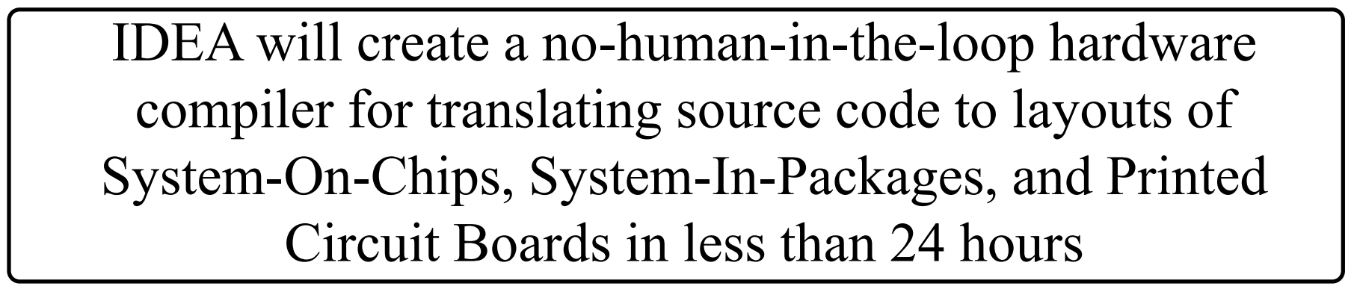
U.S. DARPA IDEA: No-Humans, 24-Hours
A. Olofsson, DARPA
ISPD-2018 keynote
Part of DARPA Electronics Resurgence Initiative
Traditional focus: ultimate performance, power, area
IDEA focus: ultimate ease of use and runtime
Restore designer access to silicon
Notes:
How do you change hardware design so that it is LESS difficult, needs FEWER EXPERTS, and COSTS less?
The obvious answer is a combination of automation and intelligence, with “self-driving” design tools and flows. And there is open source.
In 2018, DARPA launched the IDEA program as part of the U.S. Electronics Resurgence Initiative. The IDEA program aims for Hardware Compilers 2.0 – no humans, 24-hour turnaround time, eventually with zero loss of quality.
[CLICK] This shifts the focus FROM tools that enable expert users to achieve ultimate PPA, TO SELF-DRIVING tools that don’t require experts or time to tape out a working chip.
[CLICK] Leading to democratization of hardware design

Slide 7
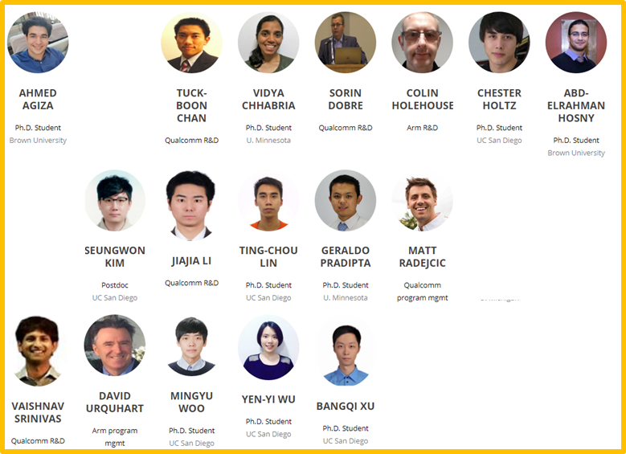
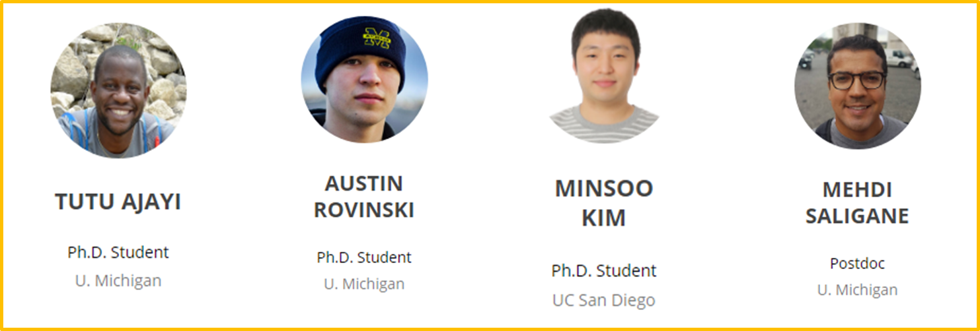
OpenROAD’s Design advisors & Developers
Original proposal:
OpenROAD would be developed by Ph.D. students and post-docs at four universities.
Separately, a fifth university would be the “internal design advisors”
Vision: span product engineering, expert user testing
Developers
Internal Design Advisor
OpenROAD Flow
OpenROAD Tools
Notes:
So who are the design advisors ?
[CLICK] In the case of OpenROAD --- originally, we proposed to develop the whole thing with Ph.D. students and post-docs at four universities.
[CLICK] Separately, students
and post-docs at a fifth university would serve in an “internal design advisors” role – users, product engineers, and AEs all rolled together.

Slide 8
OpenROAD’s Design advisors & Developers
Key point:
clear separation between “internal design advisors” and “tool developers” is built into OpenROAD
Tools Development
PPA Assessment
Calibration Data
Flow Maintenance and Automation
Developers
Internal Design Advisor
OpenROAD Flow
OpenROAD Tools
Notes:
[CLICK] We built in this separation to ensure that when commercial tools are used to report metrics to DARPA, the students who write the tools aren’t the ones doing this. So… that was the vision…
So the internal advisors are in charge of the flow, PPA assessment and calibration data while developers are in charge of the tools
I would say a KEY LESSON learned: Open-source EDA goes beyond academic research skillsets.
Over time and changing needs, The separation became less obvious as we noticed tools being developed by design advisors to address the finishing step or antenna rule checkers and vice versa
In fact, very soon we knew we needed a dedicated, experienced EDA architect and technical manager from outside the team.

Slide 9
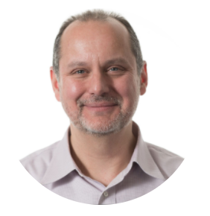
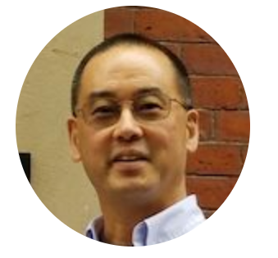
OpenROAD’s Design advisors & Developers
Tom Spyrou
Industry
Prof. Andrew Kahng
Academia
Tools Development
PPA Assessment
Calibration Data
Flow Maintenance and Automation
Developers
Internal Design Advisor
OpenROAD Flow
OpenROAD Tools
Notes:
The OpenROAD project, led by Pr. Andrew Kahng, figured out how to make this happen.
Tom Spyrou has been OpenROAD’s chief architect since July of last year with multiple other industry veterans who share the vision of open-source EDA

Slide 10
Evolution of OpenROAD-flow
July’19: Alpha-Release
Initial Implementation
Separate binaries
Patchwork of config. files
Notes:
Now, let’s have a look at the not so long history of Openroad and the evolution of the flow since this project was launched.
A year ago, Openroad showed a proof of capability being automatic generation of design rule-clean layout in a 65nm technology
The alpha release of OpenROAD used separate binaries for each tool and relied on a patchwork of configuration files and command-line arguments to run each tool in a similar way to the “1980s EDA” flows.

Slide 11
Evolution of OpenROAD-flow
July’19: Alpha-Release
Initial Implementation
Separate binaries
Patchwork of config. files
https://github.com/YosysHQ/yosys
https://github.com/The-OpenROAD-Project/alpha-release
Notes:
It is important to note that a lot of these binaries have been developed previously such as Yosys from Clifford
Or Physical design tools that originated either from prof. Andrew Kahng research group or from other Co-Pis and project consultants
The internal advisors worked closely with the developers to mitigate all the interfaces mismatches between tools .
In fact these tools varied in maturity and some of the P&R steps were not available.

Slide 12
Evolution of OpenROAD-flow
July’19: Alpha-Release
Initial Implementation
Separate binaries
Patchwork of config. files
Jan’20: Beta-Release
Shift to a unified database interface
Tools integrated in the unified app
Notes:
Our tool performs the “RTL-to-GDS” chip implementation flow, starting with logic synthesis and ending with a GDSII tapeout database.
Early this year, during the January IE, we have released our first version of our tool using a modern integrated architecture. The largest improvement to OpenROAD-flow was the shift from a file-based interface to a unified database interface
Once the tools were integrated into the unified app, all interfaces were also unified into a single binary with a Tcl interface for the users

Slide 13
Evolution of OpenROAD-flow
July’19: Alpha-Release
Initial Implementation
Separate binaries
Patchwork of config. files
Jan’20: Beta-Release
Shift to a unified database interface
Tools integrated in the unified app
Aug’20
Support of new nodes:
14nm finFET
Open-sourced SKY130
Addition of KLayout to support DRC/LVS
Early-on optimization (placement, CTS)
Notes:
The OpenROAD-flow has expanded its support to include 14nm FinFET and the newly open-sourced SkyWater 130nm platform. In addition, open-source DRC and LVS are available through KLayout;,
As shown in this diagram, In addition to adding more flow stages, another key element is to simplify the user’s flow interactions.
To do so, the important data preparation step is used to minimize the number of user adjustments needed to set up a commercial PDK, such that it is usable by OpenROAD-flow.
Optimization, while not explicitly shown, is embedded in the placement and CTS stages.
I also would like to highlight that this work is driven by the internal advisors who consists of a handful of phd students and researchers and cannot be compared in any way to the legions of engineers at the commercial EDA houses

Slide 14
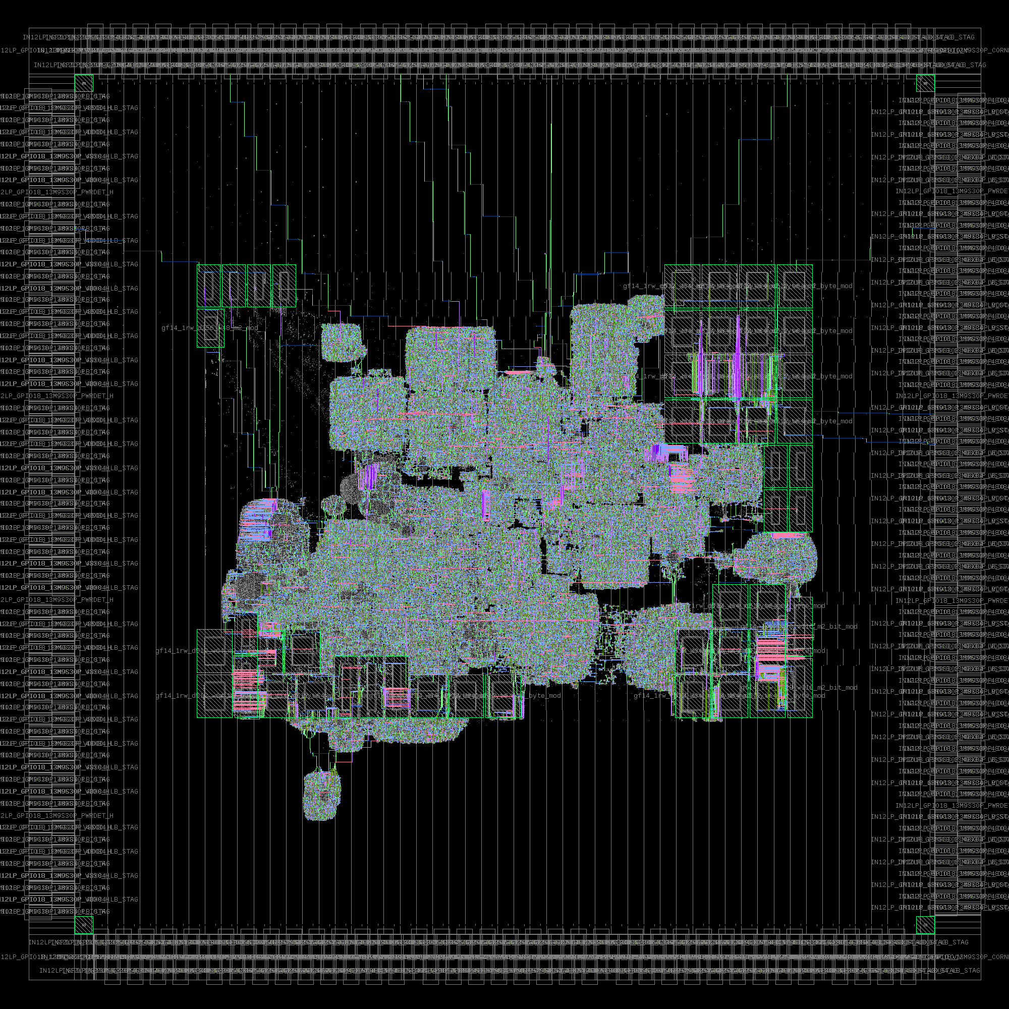
Challenges - Roadmap
Development and maintenance of OpenROAD-flow
Ambitious goals
Aggressive timeline
Notes:
The openROAD project has been following a very aggressive timeline summarized in the following figure.
In mid-July, we achieved an automated, totally clean result --- by which I mean DRC, LVS, Antenna all clean in Calibre --- for a single-core version of the University of Washington BlackParrot SOC. This was implemented in GF12LP using Arm 9-track cells, Arm SRAMs, and Invecas IOs in the same 3mm x 3mm package design that the BlackParrot team had used for their original GF12 tapeout.
The openroad team is already tackling the QoR through improving the timing engine of the openroad app. And multiple features are under development in addition to new process nodes support.
Developing and maintaining the OpenROAD-flow has led to several challenges along the way to meeting OpenROAD’s development schedule goals. In the next slides, I ll go through the main gaps and issues that we have faced.

Slide 15
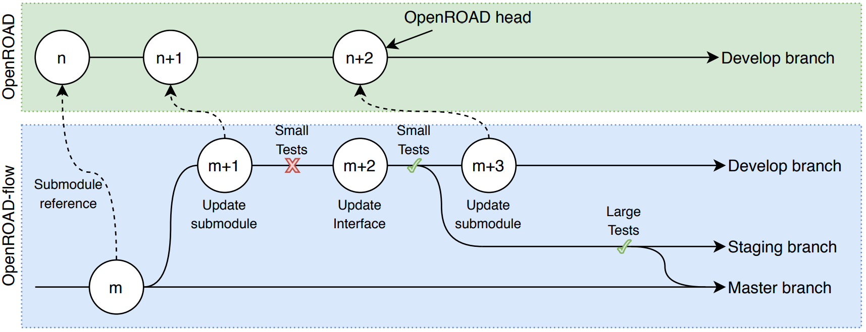
Challenges – Tool Synchronization
Regular and asynchronous updates to OpenROAD-flow
Notes:
The continuous integration infrastructure has been introduced to the OpenROAD project to help ensure integrity and quality of the codebase …
In this diagram, you can see the three key branches: a tool’s develop branch, the staging), and the master branch.
The ‘develop’ branch maintains day-to-day development activities – it runs unit tests and tool regression tests
All contributions under the form of a PR are issued to ‘develop’.
Changes merged to the ‘openroad’ branch are tested against the end-to-end flow.
repo owners initiate this merge to ensure that tools still run within OpenROAD flow.
Finally, The ‘master’ branch holds a stable release of the codebase
This methodology allows asynchronous updates to the tools submodules and ensure stable versions to be merged to the master branch.
We also separate tests into small pipe-cleaning tests and large QoR tests across separate Jenkins pipelines which are triggered by separate branches.
The main reason for this strategy is to reduce build server load: and if a large QoR test is triggered from every commit, the build server can quickly become overloaded.
So instead, we use automatically triggered small tests for every commit to the development branch, while the large tests are performed only on merges to the “staging” branch.

Slide 16
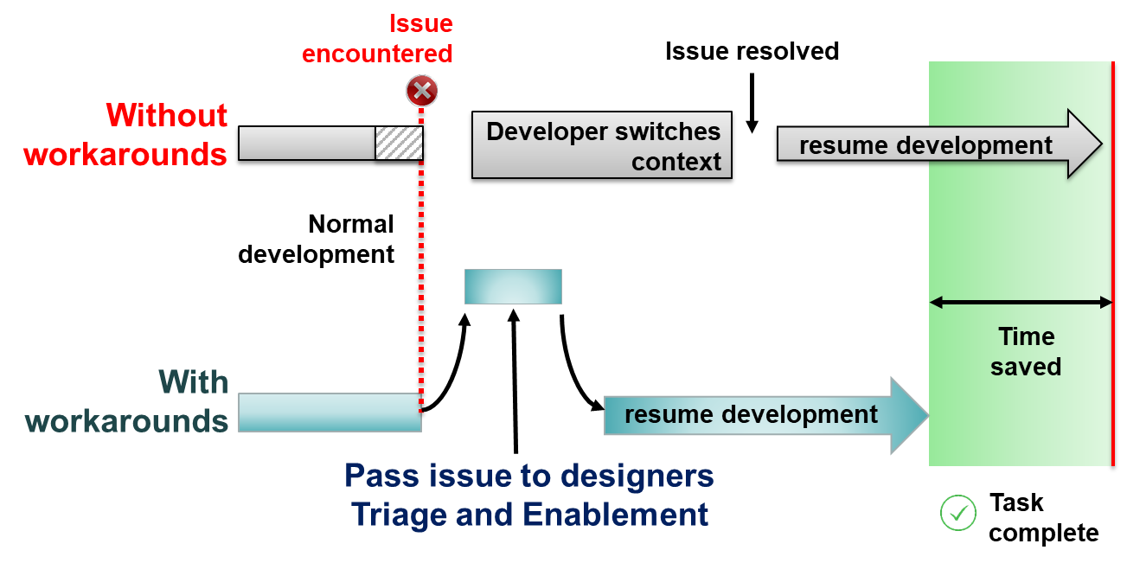
Challenges – Tool Workarounds
Tool developers can focus on critical issues
The OpenROAD project can meet its major schedule milestones
Examples of workarounds:
Interfacing format issues (i.e. DEF output inconsistencies between tools)
Enabling partial support (i.e. interconnect parasitics)
Flow workarounds are a balancing act of meeting schedule demands and accumulating technical debt
Notes:
Another challenge faced by the design advisors is what we call Tool workarounds.
As illustrated in the figure on the right, in cases where the root issue resided between tools, the design advisors would often be able to perform external processing as a workaround for lack of tool support. This allowed developers to focus on more critical issues.
Some previous examples include fixing inconsistent DEF outputs between tools, fixing technology-dependent tool issues, and adding partial support for yet-to-be-supported file formats (e.g., interconnect parasitics).
To address this, we needed a flow able to pass designs through all available steps provided by the development team. This included the ability to skip or work around flow steps as necessary. Therefore, the earliest iterations of our flow leveraged commercial tools to generate “clean” artifacts (DEFs, floorplans, guides, etc.)
It is important to not that Several of these workarounds have enabled the development team to hit our schedule for 14nm node support, but now underlying issues must be thoroughly investigated to reduce the induced technical debt.

Slide 17
Challenges – Parameter Tuning
Substitutes the user design intent by an automated process
Developers need isolated design cases to identify root causes
Notes:
openroad flow’s vocation is to be a highly automated flow. It is thus important to identify design intent and constraints early on in the flow stage and translate that into relevant decisions.
To achieve this vision, the design advisors and developers are working closely to automate much of this process and build the intelligence able to select and tune design parameters, such as design area and utilization, cell placement padding, and global routing settings.

Slide 18
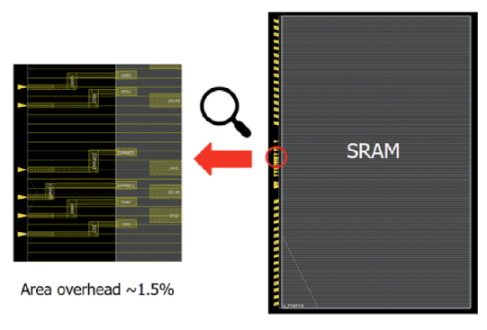
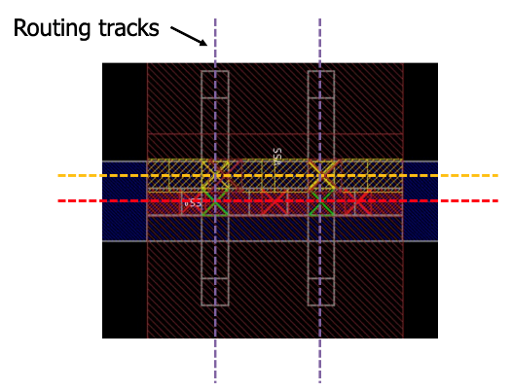
Challenges – Generic Node Enablement
Highly complex design rules characteristic to FinFET technology nodes
Bringing up TritonRoute detail router in sub-20nm in a tight schedule and resources
Enforced routing assumptions to minimize the burden on the router:
Unidirectional and on-track routing
Minimum-width routing
On-track pins for macro cells
Routing-friendly P/G distribution
Notes:
The last challenge I would like to mention in this talk is related to routing
Detailed routing for FinFET technology nodes is a significant challenge. A routing tool must understand all of the hundreds of complex design rules in order to properly route designs without violations.
As internal design advisors, helping TritonRoute to achieve zero DRVs with limited time and resources was a significant challenge. Following the “generic node enablement” methodology , we made and enforced assumptions in routing rules to minimize the required design rule support: Unidirectional routing makes design rules much simpler. Especially for double-patterning technology routing layers, judicious choices for only the end-to-end and side-to-side spacing rules can cover most of the foundry design rule set for routing layers. Furthermore, one of the most difficult challenges with advanced nodes is for tools to correctly understand advanced design rule syntax.
Another aspect to the general node enablement is the handling of macro cells
For that, we adopted a wrapper over the SRAM cells to aligns pins to the routing tracks. For example, , as shown in the figure on the right, the wrapped SRAM has extra space near the pins and extended to have on-grid locations. The area overhead is less than 1.5%

Slide 19
Test Infrastructure – Design Suite
Provide a real-world suite of design test cases without overwhelming the early OpenROAD tool capabilities
Relaxation of design features
Dense floorplan
Multiple power domains
Multiple clocks
Circuit-level techniques
Notes:
To be able to test the openroad tools properly, real world design test cases are needed.
The original intent of the design advisors was to curate a suite of test cases based on previous tapeouts of real designs.
We quickly ran into several issues that prevented us from creating meaningful test cases for the developers.
In fact, A modern SoC would be composed of multiple cores, Analog and mixed signals Ips, interfaces and other design components depending on the applications.
This often means a diverse and dense floorplans, multiple voltage and power domains, multiple clocks and sometimes circuit level schemes

Slide 20
Test Infrastructure – Design Suite
Provide a real-world suite of design test cases without overwhelming the early OpenROAD tool capabilities
Design features Relaxation
Digital
Single clock
No partitioning
Single voltage domain
O(10-100) RAMs macros
Notes:
To address this, we stripped down the test cases to accommodate the tool capabilities, and meet the project milestones and specific features we needed to evaluate.
As illustrated here, timing constraints files were simplified to address a single clock, with no support to partitioning
a single voltage domain, and a fairly acceptable range of SRAM Macros going up to 100s of cells

Slide 21
Test Infrastructure – Design Suite
Provide a real-world suite of design test cases without overwhelming the early OpenROAD tool capabilities
Design complexity relaxation
Digital
Single clock
No partitioning
Single voltage domain
O(10-100) RAMs macros
Analog
No PMU support
Simplified Digital Clock gen.
No custom / tr. level circuits
Notes:
Timing based on a single clock is possible. However, Analog design isn’t handled yet in the flow such as handling power intent files

Slide 22
Test Infrastructure – Design Suite
Provide a real-world suite of design test cases without overwhelming the early OpenROAD tool capabilities
Design complexity relaxation
Digital
Single clock
No partitioning
Single voltage domain
O(10-100) RAMs macros
Analog
No PMU support
Simplified Digital Clock gen.
No custom / tr. level circuits
Interface
IOs only
Digital interfacing is possible
Notes:
Finally, OpenROAD-flow provides full-chip designs with I/O rings, enabling developers to test tools at the SoC level rather than only at the block level
Proprietary CPUs and IPs oriented the design advisors toward open source designs such as RISCV cores. It is important to maximize shareability and thus commercial IPs were removed as well
In fact, as the tools matures, we are progressively tightening design constraints and adding more features and test cases from the open-source community.

Slide 23
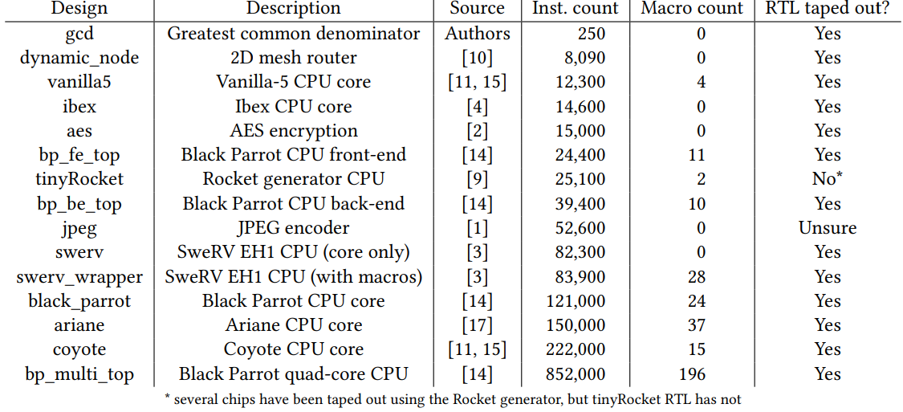
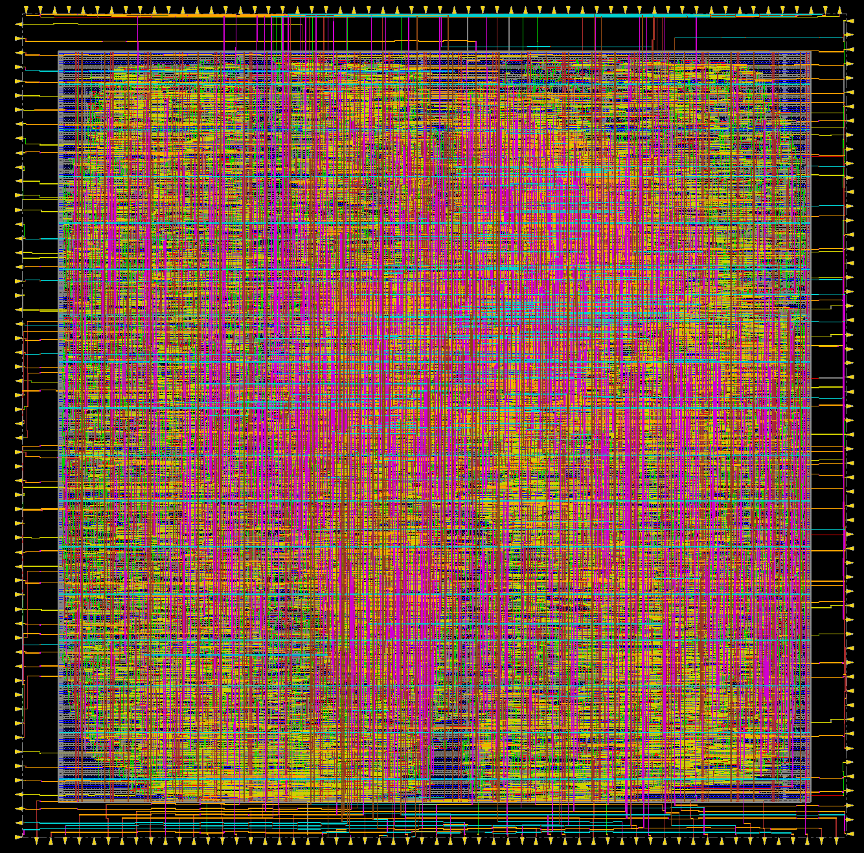
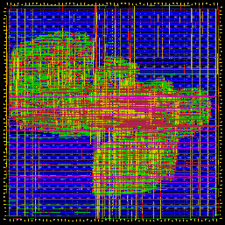
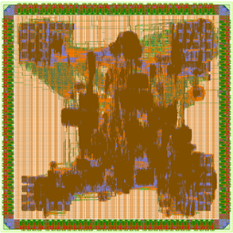
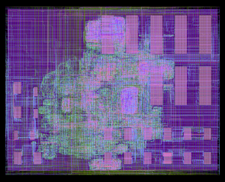
Test Infrastructure – Design Suite
As tools are gaining in maturity, new test cases / features are included in the design suite
Notes:
Here you can see a summary of the design suite within the openroad flow repo. On the left are testcases implemented in 65nm and gf14 using our flow , in the second row we can the BP with 2 cores and the swerve design with macros in gf12lp

Slide 24
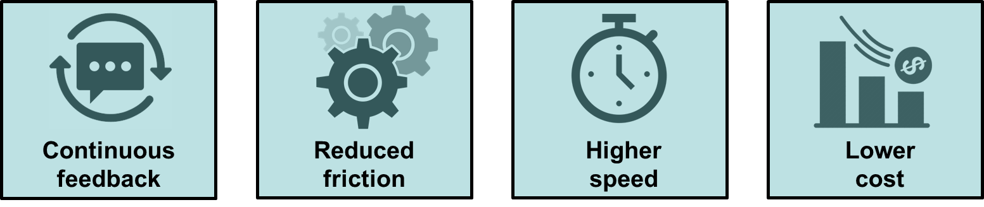
Test Infrastructure – CI
Aims to automate development processes and best practices
Issues and limitations:
Issue reporting
Delayed feedback
Portability
Challenges:
Test scale
Large design = higher computation time
Private tests
Secure data
Code
Build
Test
Test
Subset test
Full
test
Private CI Server
Notes:
Continuous Integration is commonly accepted as game changer that allows to pin point broken code changes. It has been applied to many fields and the EDA tooling is benefiting in its turn from such infrastructure
This is another area which was not clearly enumerated in the original project task structure. By introducing the CI, it is possible to build and test the tools individually and if successful , it tests the new code changes within the OpenROAD flow.
This ensures that the Openroad unified build environment isn’t compromised by the code changes. Then, available test cases are run in parallel. Some of them are small and take a few minutes, but others can take longer.
The end-to-end pipeline can take a few hours, but the bright side the developer do not have to initiate or babysit this process.
Ultimately, this ensures that new code contributed by the open-source community is safe to merge and doesn’t cause a problem that someone needs to track down in the future.

Slide 25
OpenROAD Today and Next Steps
July 2019: Proof of capability
DRC-clean RTL-to-GDS, 65nm
“File-based flow” 1980’s EDA
July 2020: v1.0 EDA tool
DRC-clean RTL-to-GDS, 12nm
UW’s “BlackParrot” SoC
Integrated tool, modern EDA
Present:
QoR improvements (Timing)
Tapein Signoff
Single-core BlackParrot, final netlist ~530K insts, 49 SRAMs, clean DRC, LVS, Antenna checks in Calibre on July 15. (GF12LP, Invecas IOs, Arm 9T cells and memories.)
Notes:
Back to our roadmap,
In mid-July, we achieved an automated, totally DR clean result of the black- a great milestone but what comes next? Timing..
PPA analysis has been an important part of our work, thus we have spent a considerable effort looking into our timing reports, tweaking hold and setup constraints to meet a reasonable signoff target.

Slide 26
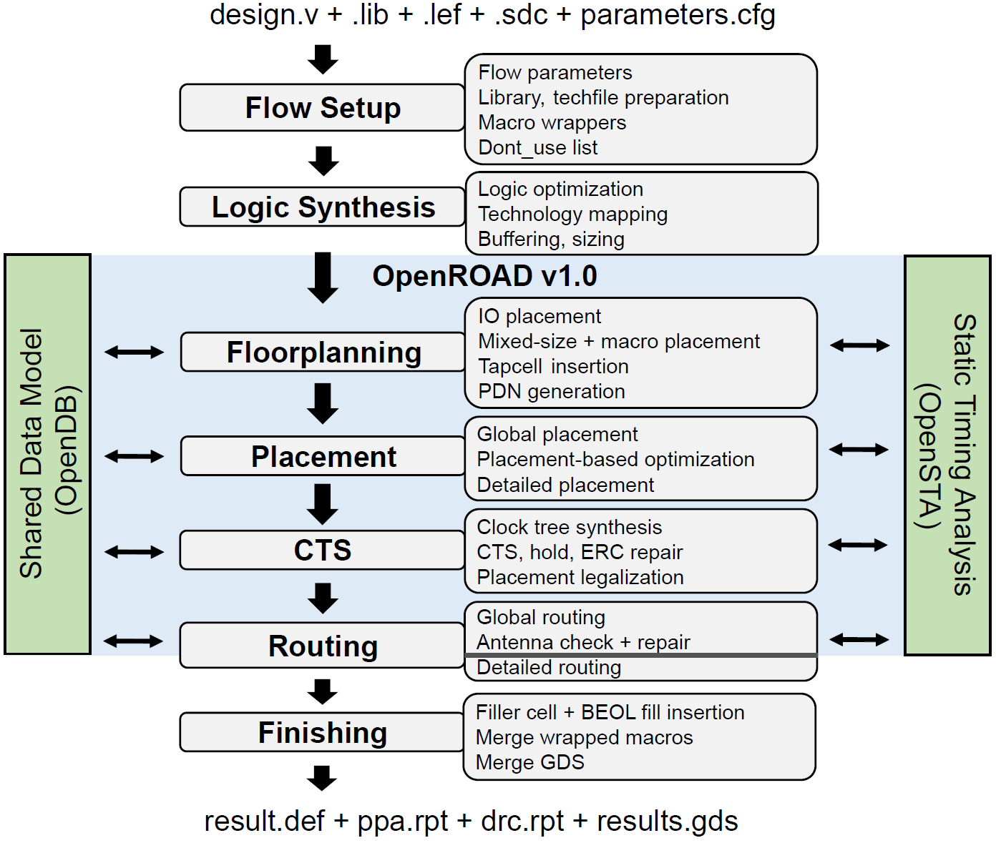
OpenROAD Today and Next Steps
July 2019: Proof of capability
DRC-clean RTL-to-GDS, 65nm
“File-based flow” 1980’s EDA
July 2020: v1.0 EDA tool
DRC-clean RTL-to-GDS, 12nm
UW’s “BlackParrot” SoC
Integrated tool, modern EDA
Notes:
And so this is where we are today.
The Integrated App “openroad” is in blue, and is tightly tied into the timer and the DB. Most of our tools are integrated today, and are sitting in a mono-repo. This trend of consolidating repos and not using submodules is accelerating in our project.
There are three other executables in the flow: Yosys for synthesis, TritonRoute for detailed routing, and Klayout for layout finishing and GDS merge.

Slide 27
Toward Full Autonomy
Improve User Experience
Documentation
Enhance problem solving abilities
Accessibility
OS support/compatibility
Software packaging
Reduce Manual Effort
Automatically extracted parameters
~ 50 configuration parameters
Reduce Manual Effort
Manually tune parameters
OpenROAD-flow
Notes:
As mentioned earlier in my talk, full autonomy of the flow isn’t an easy task and is expected to happen gradually as the flow matures.
As a short term goal, we aim to improve the user experience and make it more intuitive. Both the novice and expert users should be able to run a design through with a minimal manual effort.
Documentation and improving the tool errors reports and warnings should make the flow issues resolution more fluid and highly effective

Slide 28
Toward Improved Results
Providing a clean and manufacturable design without
human intervention
Autonomous
RTL-to-GDS flow
Inter-tool Feedback
Automatic golden correlation
New flow features
Enhance QoR
Automatic Clock Gating
Multi-voltage
Partitioning
Full-stack solution
Parasitic Extraction
Notes:
As a reminder: Our mission is to achieve 24-hour no-humans RTL-to-GDS in advanced foundry nodes, WHILE catalyzing an open-source ecosystem for researchers, tool developers and users.
Keeping this in mind, our philosophy is to make the flow autonomy central to any new developments or enhancements. QoR although coming as secondary is expected to be improving over times and the short comings such as loosen up timing are being addressed as we speak.
Automatic golden correlations as well as new features are on our radar. Design Techniques such as ACG, multi-V or partitioning are being investigated as we speak along with parasitic extraction tools – such as openRCX
By this, I end my talk and invite you to read our paper for more details. thanks

Slide 29
Thank You!

